Slide 1
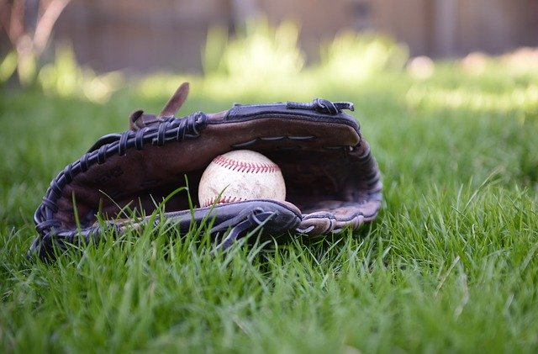
Nutrition for Young athletes
Supportive nutrients for athletic performance, recovery, & injury prevention

Slide 2

My background
Mom to 3 kids, oldest Bodhi is 10 years old and on Golden Spikes 10U Titans team
Naturopathic Doctor: Medical degree from Bastyr University in 2005
Practicing most of that time in holistic pediatrics and women’s health
Interest in sports medicine came from own experience, local triathlons, and now kids getting into athletics

Slide 3
Naturopathic Medicine
Naturopathic Medicine is a system of primary healthcare that blends modern scientific knowledge with traditional and natural forms of medicine. It emphasizes the use of natural modalities - such as nutrition, lifestyle, and herbal medicine - to promote wellness and treat illness

Slide 4


Slide 5
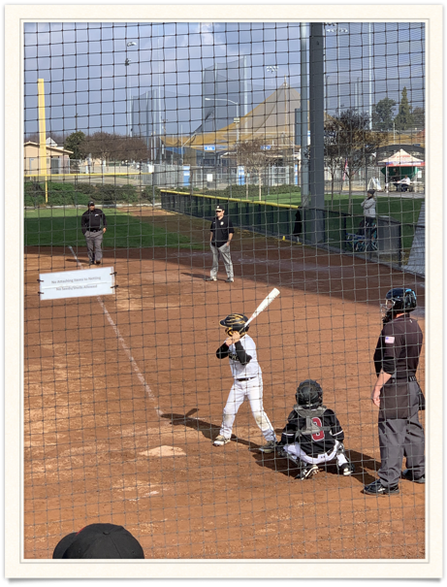

When we talk about being a competitive athlete or functioning at a high level, obviously there are many aspects to this:
  Effort and attitude
  Personal motivation
  Mental toughness
  Physical fitness
  Genetic talent/athletic ability
  Desire
  Repetitive training
  Stamina
  Recovery

Slide 6
GOAL of today’s Talk
Effective use of energy (ATP) to perform at their best
Muscle Recovery
Prevention of repetitive injuries

Slide 7
DISCLAIMER:
This is not meant to provide specific individualized medical advice, but is an educational seminar overview of the options available and ways to
promote health and performance of youth athletes.

Slide 8

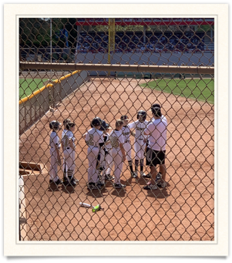
FUNDAMENTALS
SLEEP: 11-14 year olds should sleep 10 hours a day; good quality uninterrupted sleep
HYDRATION: Goal is ½ body weight in ounces daily (not counting additional loss from exercise and sweat)
HEALTHY DIET

Slide 9
C.O.M.P.E.T.E
C = COLLAGEN
O = OMEGA 3 OILS
M = MAGNESIUM / MINERALS
P = PROTEIN
E = ELECTROLYTES
T = TURMERIC
E = “EAT THE RAINBOW”

Slide 10
COLLAGEN
WHAT IS IT?
Collagen is a fibrous protein that provides the strength and structure to our bodies.
Collagen benefits our hair, skin, bones, joints, tendons, ligaments, nails, and gut wall lining.
For athletes, most stress of training impacts the muscles, joints (bones) and the tissues that connect the 2 together, which are TENDONS and LIGAMENTS. These fibrous tissues are often susceptible to injury.

Slide 11
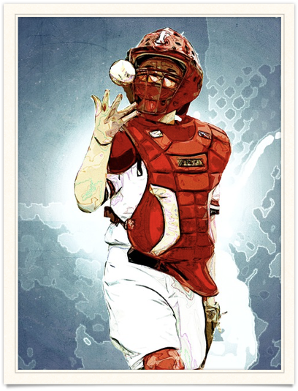
As it is a building block for these tissues, COLLAGEN can also provide strength and tensile force for tendons and muscles.
INJURY PREVENTION
& RECOVERY
is the biggest benefit of collagen
As it is needed to repair and replace those tissues that get worked/used most by athletes

Slide 12
What are the sources of collagen?
–Best source of collagen is from same structures of animals: tendons, bones, skin, joints
Broths made from chicken, fish, beef
Chicken or salmon skin, egg yolks have some collagen
Only real vegetarian sources are legumes and algae
Also gelatin and collagen powders are available as powdered broths OR tasteless powders

Slide 13
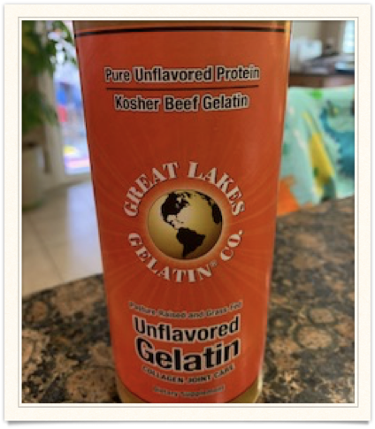
I make gelatin / collagen fruit jello (my kids don't know!)
Or I add it to a protein smoothie post-exercise
Recipe: 1T gelatin powder, 1T collagen powder, ½ cup hot water to dissolve, 2 cups fruit juice (not citrus)
Links to recipes available

Slide 14
OMEGA 3 OILS
Likely many of you have heard of Omega 3 oils and probably some of you are taking them as vitamins
What are they?

Slide 15
Omega 3 oils
Omega 3 oils are essential fatty acids
A fancy term for “GOOD FATS” and essential means you can’t make them yourself
What is the difference between a
“good fat” and a “bad fat”??
HOW OUR BODY PROCESSES THEM
Good Fats - anti-inflammatory, flexible, develop healthy cells and communication between cells
(Examples are DHA and EPA)
Bad fats - inflammatory, sticky, ‘hardens’
(Examples: “hydrogenated and partially hydrogenated” oils and higher fat farmed meats and dairy)

Slide 16
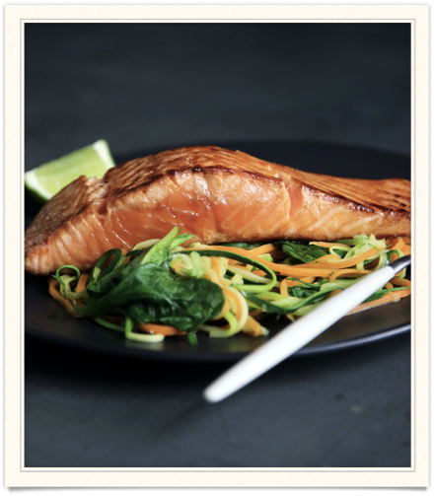
Omega 3 oils
Anti-inflammatory
Oils lubricate the joints and provide moisture to protect joints from wear and tear
Our body uses fats to build our brain cells, nerves, and outer membranes for ALL of our cells, so what fats we consume is EXTREMELY important for how our body functions

Slide 17
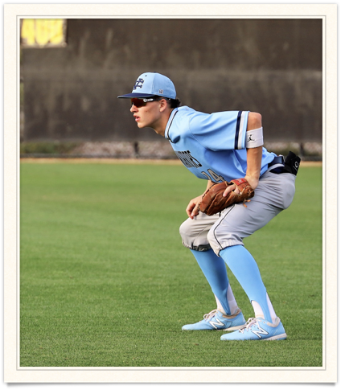
Healthy brain = focus
We all know to be an athlete is more than just physical ability…
The mental aspect of the game, and the quickness needed for hand/eye coordination and split second decision making -
That requires a healthy brain and healthy nervous system

Slide 18
Magnesium
Magnesium is a cofactor in over 300 enzyme reactions in the body, so it is important for almost every system in the body, but especially for energy metabolism, muscles and bones.
Multiple studies have shown well over 50% of population is deficient in magnesium
Most importantly magnesium is necessary for BUILDING MUSCLE and for muscle FUNCTIONS, as well as ENERGY PRODUCTION in the cell mitochondria energy centers

Slide 19

Magnesium Burn Rate
Simplified:
Mg burn rate is a way of calculating how much magnesium you need based on how much your body uses, and this calculation is made based on the amount the body “processes information” daily, or daily stressors.

Slide 20
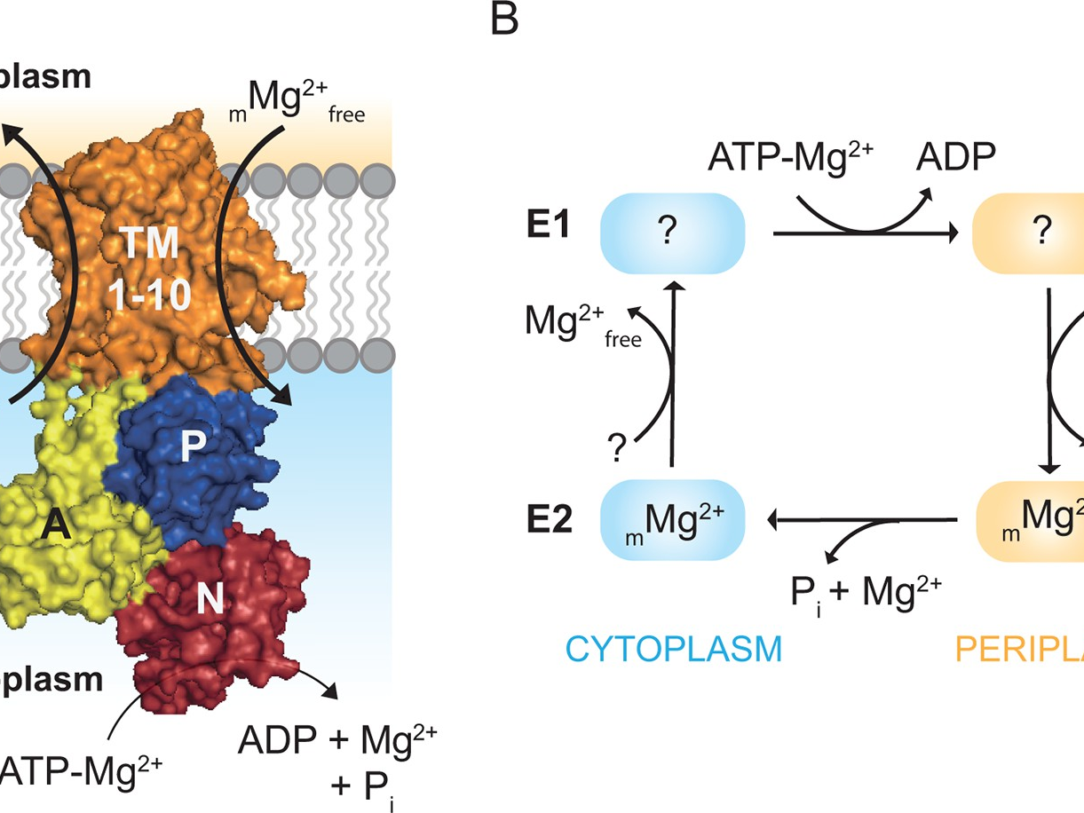

Slide 21
Symptoms of low Mg
Body / Muscle Aches
Poor recovery after exercise
Sleep restless or disturbed
Muscles cramping or twitching
Growing pains (especially at night)
Anxiety, especially at night
Tight muscles or inflexibility
Not sweating
(And more)

Slide 22
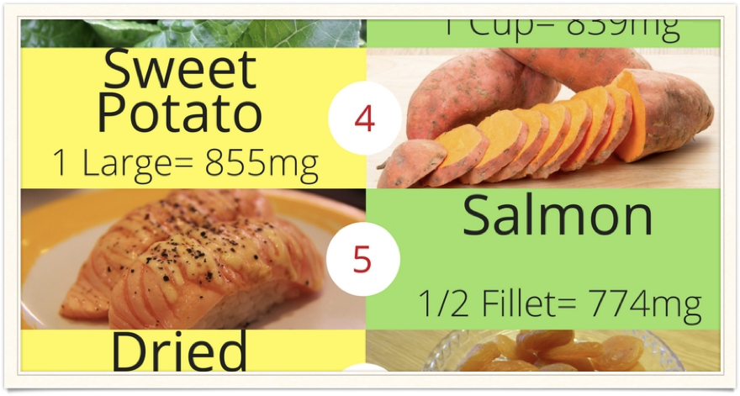
Magnesium Sources
Most nuts and seeds, beans, avocados, green vegetables

Slide 23
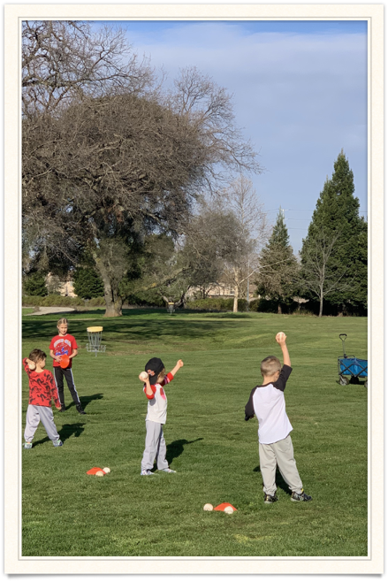
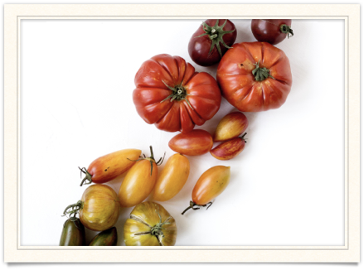
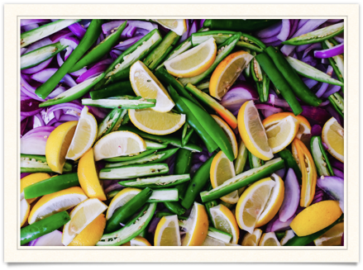
QUESTIONS?

Slide 24
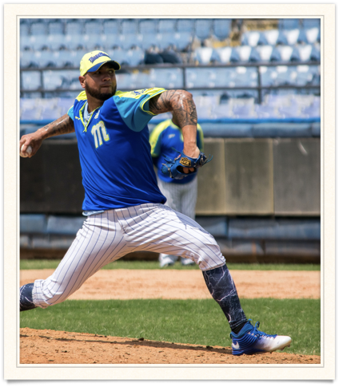
Protein
Protein is all about muscles
Building and repairing muscles…
Protein increases muscle mass and muscle strength,
And it is also involved in building blood cells, bones, and hormones.
For a teenage athlete, building hormones means GROWTH in general - not just muscle mass but growth hormone, height and strength.

Slide 25
Athletes typically need more total calories and more protein than children their age that are not as active.
A good rule of thumb for protein minimums for active kids is 1 gram/kilogram or 1 gram to approximately 2.2 lbs, so good ballpark is ½ gram per pound. Upper limits are .6-0.9 grams per pound.
So If your son weighs 80 lbs, he needs about 40 grams of protein daily as a minimum, and 72 grams max.

Slide 26
Example Protein Amounts:
1 hardboiled egg = 6 grams protein
¼ cup almonds = 12 grams
Turkey lunchmeat = 18 grams
3 ounces steak = 25 grams
½ cup beans = 9 grams
All above would equal 70 grams of protein, so that would be ideal for 100 lb kid

Slide 27
Electrolytes
What are electrolytes?
Effectively they are mineral salts that are lost thru the skin when we sweat…
Main ones are sodium, potassium, magnesium, phosphorus, chloride
Our bodies are 70% water - mostly that water gets lost when we sweat, and when you replace WATER without electrolyte salts, an imbalance is created. The water cannot get into the cell to create energy.
Electrolytes control the actions in the body: Ex. When your brain tells your muscles to contract, the body uses sodium or potassium channels to get the contraction to happen.

Slide 28
Sure signs of electrolyte ‘depletion’ are muscle soreness and muscle cramping, but it also can cause some nausea and fatigue.
Ideally we are able to get electrolytes and hydration prior to workouts, but during workouts - Especially on hotter days when sweat is increased, we may need electrolyte salts or powder in kids’ drinks during their workouts.
After long weekends or competitions, if your child is complaining of soreness or cramping, this is the first thing to add/replace.

Slide 29
Electrolyte sources
You can use pure sea salt in water or electrolyte liquid drops that are made from dissolved minerals from Salt Lake, Utah.
Salty foods (soups, crackers, etc) are excellent before or during game breaks, as long as they are also drinking water.
Electrolyte chews or electrolyte tablets are another good solution during workouts that are over 2 hours, back to back games.
Why are sugar-filled electrolyte drinks not ideal choice?

Slide 30
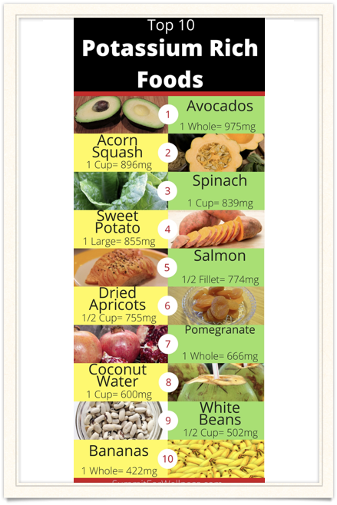
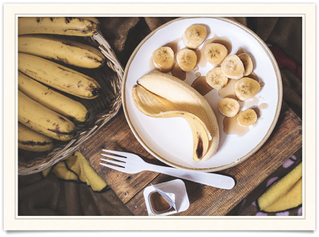
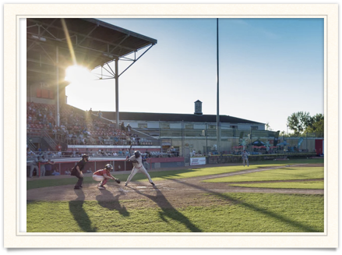

Slide 31
TURMERIC
Anti-Inflammatory
Master Herb
What is it?
Turmeric is a food spice
Mostly recognized as ingredient in Indian and Asian curries that makes them golden in color
In concentrated form,
The active ingredient is known as curcumin

Slide 32
Why is inflammation an issue?
Do kids have inflammation?
Athletes intentionally generate inflammation in the body as a way of promoting blood flow and tearing down to rebuild their muscles and connective tissue
NSAIDS
Reducing inflammation “garbage” reduces soreness and optimizes recovery

Slide 33

Eat the rainbow
Red - Orange - Yellow - Green - Blue - Purple

Slide 34
Different colors = different nutrients
Red = lycopene, lutein, flavonoids
Orange and Yellow = Carotenes, Vitamins A, C
Green: B vitamins including folate, vitamin E, chlorophyll
Blue and Purple =
Flavonoids, resveratrol

Slide 35

The simple reason vitamins or nutrients from healthy foods are so crucial:
if your body doesn’t consume vitamins,
it can’t make them,
so it simply will do without them.
Example: Iron
if we don’t have enough of a nutrient, our VO2 Max suffers, our endurance and stamina suffers, and our recovery suffers

Slide 36
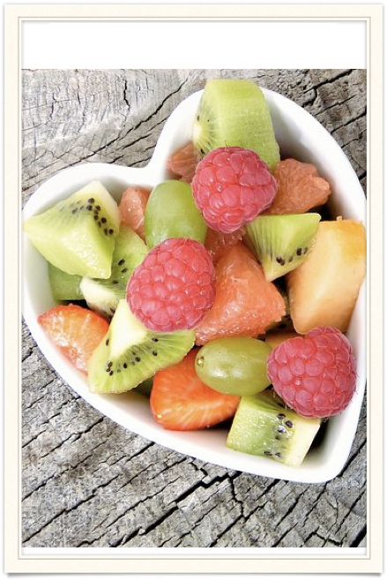
1 serving = baseball
Goal is 5-7 servings daily

Slide 37
“Exercise is king. Nutrition is queen. Put them together and you have a kingdom”
–Jack Lalanne
Thank you for listening!
I have a resource sheet I will send out with recipes and links :)

